Slide 1



Looking Inside Large Language Models
Chapter 3

Slide 2


Transformers
At a high level of abstraction, Transformer LLMs take a text prompt and
output generated text.

Slide 3
Transformer, how generate text?
An output token is appended to the prompt, then this new text is presented to the model again for another forward pass to generate the next token.
Notes:
This gives us a more accurate picture of the model as it is simply predicting the next token based on an input prompt. Software around the neural network basically runs it in a loop to sequentially expand the generated text until completion.
They’re called autoregressive models. That is why you’ll hear text generation LLMs being called autoregressive models.

Slide 4
Decoding
At the end of the forward pass, the model predicts a probability score for each token in the vocabulary.
Notes:
The flow of the computation follows the direction of the arrow from top to bottom.
For each generated token, the process flows once through each of the Transformer blocks in the stack in order, then to the LM head, which finally outputs the probability
distribution for the next token.
The easiest decoding strategy would be to always pick the token with the highest probability score. In practice, this doesn’t tend to lead to the best outputs for most use cases. A better approach is to add some randomness and sometimes choose the second or third highest probability token. The idea here is to basically sample from the probability distribution based on the probability score, as the statisticians would say.
Choosing the highest scoring token every time is called greedy decoding. It’s what happens if you set the temperature parameter to zero in an LLM.

Slide 5
Caching Keys and Values
When generating text, it’s important to cache the computation results of previous tokens instead of repeating the same calculation over and over again.
Notes:
Recall that when generating the second token, we simply append the output token to the input and do another forward pass through the model. If we give the model the ability to cache the results of the previous calculation (especially some of the specific vectors in the attention mechanism), we no longer need to repeat the calculations of
the previous streams. This time the only needed calculation is for the last stream. This is an optimization technique called the keys and values (kv) cache and it provides a significant speedup of the generation process. Keys and values are some of the central components of the attention mechanism, as we’ll see later in this chapter.

Slide 6
Transformer block
A Transformer block is made up of a self-attention layer and a feedforward neural network.
Notes:
A Transformer block (Figure 3-12) is made up of two successive components:
1. The attention layer is mainly concerned with incorporating relevant information from other input tokens and positions
2. The feedforward layer houses the majority of the model’s processing capacity.

Slide 7
Self Attention
The self-attention layer incorporates relevant information from previous positions that help process the current token..

Slide 8
attention mechanism:
Attention is made up of two major steps: relevance scoring for each position, then a step where we combine the information based on those scores.
Notes:
Two main steps are involved in the attention mechanism:
1. A way to score how relevant each of the previous input tokens are to the current token being processed (in the pink arrow).
2. Using those scores, we combine the information from the various positions into a single output vector.
We get better LLMs by doing attention multiple times in parallel, increasing the model’s capacity to attend to different types of information.

Slide 9
How attention is calculated
1. Before starting the self-attention calculation, we have the inputs to the layer and projection matrices for queries, keys, and values.
2. Scoring the relevance of previous tokens is accomplished by multiplying the query associated with the current position with the keys matrix.
Notes:
Attention starts by multiplying the inputs by the projection matrices to create three new matrices. These are called the queries, keys, and values matrices. These matrices
contain the information of the input tokens projected to three different spaces that help carry out the two steps of attention:
1. Relevance scoring
2. Combining information
Self-attention: Relevance scoring
In a generative Transformer, we’re generating one token at a time. This means we’re processing one position at a time. So the attention mechanism here is only concerned
with this one position, and how information from other positions can be pulled in to inform this position.
The relevance scoring step of attention is conducted by multiplying the query vector of the current position with the keys matrix. This produces a score stating how relevant each previous token is. Passing that by a softmax operation normalizes these scores so they sum up to 1.

Slide 10
Self Attention
Attention combines the relevant information of previous positions by multiplying their relevance scores by their respective value vectors.
Notes:
Now that we have the relevance scores, we multiply the value vector associated with each token by that token’s score. Summing up those resulting vectors produces the output of this attention step

Slide 11
Self Attention
Attention combines the relevant information of previous positions by multiplying their relevance scores by their respective value vectors.
Notes:
Now that we have the relevance scores, we multiply the value vector associated with each token by that token’s score. Summing up those resulting vectors produces the output of this attention step

Slide 12
Self Attention
Attention combines the relevant information of previous positions by multiplying their relevance scores by their respective value vectors.
Notes:
Now that we have the relevance scores, we multiply the value vector associated with each token by that token’s score. Summing up those resulting vectors produces the output of this attention step

Slide 13
Self Attention
Attention combines the relevant information of previous positions by multiplying their relevance scores by their respective value vectors.
Notes:
Now that we have the relevance scores, we multiply the value vector associated with each token by that token’s score. Summing up those resulting vectors produces the output of this attention step

Slide 14
Self Attention
Attention combines the relevant information of previous positions by multiplying their relevance scores by their respective value vectors.
Notes:
Now that we have the relevance scores, we multiply the value vector associated with each token by that token’s score. Summing up those resulting vectors produces the output of this attention step

Slide 15










TYPES OF AI
NARROW AI
GENERAL AI
SUPER AI
Narrow AI is designed to perform a specific task
General AI can perform any intellectual task that a human can
Super AI is hypothetical and would surpass human intelligence

Slide 16





HISTORY OF AI
The Dartmouth Conference, where the term "artificial intelligence" was first coined and AI was established as a field of research.
1956
The first AI system that could understand and respond to natural language was created by Terry Winograd, which marked a major step forward in natural language processing.
1974
IBM's Deep Blue defeated the world chess champion Garry Kasparov, demonstrating that machines could surpass human intelligence in specific domains.
1997
The emergence of deep learning led to breakthroughs in computer vision, speech recognition, and natural language processing.
2012

Slide 17



IN FINANCE
75%
12,000
50%
people said that AI has improved their decision-making process.
Morgan Chase used AI to analyze 12,000 commercial loan agreements in seconds
The use of AI in fraud detection has led to a 50% reduction in false positives

Slide 18






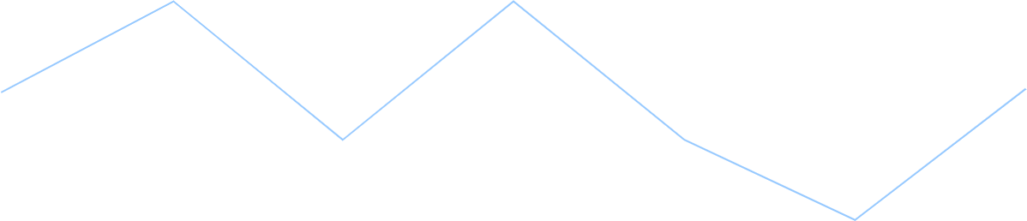

IN MANUFACTURING
Item 2
Item 3
12
10
8
6
4
2
0
2015
2016
2017
2018
2019
2020
2021

Slide 19








IN TRANSPORTATION
REDUCE 20% FUEL CONSUMPTION
REDUCE 30% MAINTENANCE COSTS
Self-driving trucks powered by AI have been shown to reduce fuel consumption by up to 20%, saving companies thousands of dollars per year.
AI-powered predictive maintenance can reduce maintenance costs by up to 30%, and increase vehicle reliability and uptime.

Slide 20






03
SOCIAL IMPLICATIONS
Explores the broader impact of AI beyond specific industries or applications. Considers ethical and societal implications such as job displacement, bias, privacy concerns, and potential impacts on democracy and human rights. Encourages a critical and thoughtful approach to AI development and deployment, taking into account the potential risks and benefits to individuals and society as a whole.

Slide 21




AI AND JOBS
JOBS AT HIGH RISK
JOBS AT SIGNIFICANT RISK
14%
32%

Slide 22



AI ETHICS
81%
People believe that companies should prioritize ethical considerations
63%
Were concerned about the ethical implications of the AI system

Slide 23
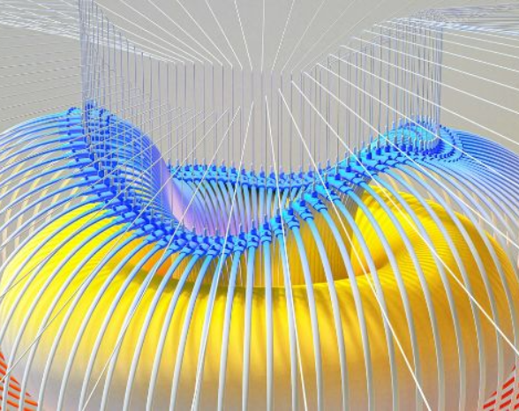

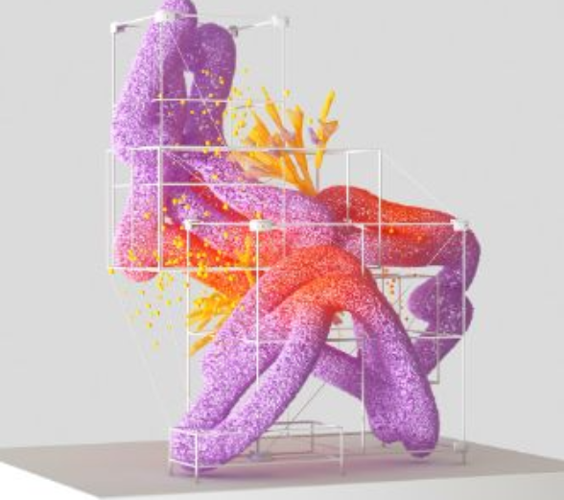

AI AND PRIVACY
A survey by Pew Research Center found that 64% of Americans are concerned about the way that companies are using their data, and 81% feel that they have little or no control over the data that companies collect about them.
20%
55%
The EU's GDPR includes provisions for ensuring that individuals have the right to access and control their personal data, including data that is processed using AI systems.

Slide 24



AI AND SOCIETY
Discusses the broader societal implications of AI, including its impact on job displacement, inequality, and social norms. This section aims to provide a comprehensive understanding of the ways in which AI is shaping our society and the challenges that need to be addressed.
04

Slide 25


THE RISE OF POWERFUL AI WILL BE EITHER THE BEST OR THE WORST THING EVER TO HAPPEN TO HUMANITY. WE DO NOT YET KNOW WHICH.
STEPHEN HAWKING

Slide 26








THANK YOU FOR
CHOOSING EATEMP
We offer free and high-quality slides templates for your presentations. We appreciate you choosing us and hope our templates have been helpful.
As a new website, we rely on your support to grow, so please help us by sharing our site with your friends and colleagues.
eatemp._
@eatemp
eatempofficial
@eatemp.official

